Slide 1
Spring Beans

Slide 2

Learning Outcome
After completing this video, you will learn:
What are Spring Beans
How they are managed by the IoC container

Slide 3
Spring Beans
Backbone of Spring application

Slide 4
Spring Beans
Overview
Java Beans are classes that encapsulate many objects into a single object (the bean).
A Bean is a POJO(Plain Old Java Object), which is managed by the spring container.
Spring Bean is an object, which is created, managed and destroyed in Spring Container.
We can inject an object into the Spring Container through the metadata(either xml or annotation), which is called inversion of control.
Notes:
The objects that form the backbone of your application and that are managed by the Spring IoC container are called beans. A bean is an object that is instantiated, assembled, and otherwise managed by a Spring IoC container.
These beans are created with the configuration metadata that you supply to the container. For example, in the form of XML <bean/> definitions which you have already seen in the previous chapters.

Slide 5
Spring Beans
Overview (Contd.)
When you create a bean definition what you are creating is a recipe for creating actual instances of the class defined by that bean definition.
Objects created by the container are also called managed objects or beans.
A Spring IoC container manages one or more beans.
These beans are created using the configuration metadata that has been supplied to the container (typically in the form of XML <bean/> definitions).
Notes:
The idea that a bean definition is a recipe is important, because it means that, just like a class, you can potentially have many object instances created from a single recipe.
From the Spring IoC containers point-of-view, everything is a bean. That’s great news for the Spring IoC container, because if everything is a bean then everything can be treated in the exact same fashion.

Slide 6
BeanDefinition
Recipe for creating objects

Slide 7
Spring Beans
BeanDefinition
Within the container itself, these bean definitions are represented as BeanDefinition objects, which contain (among other information) the following metadata:
a package-qualified class name
bean behavioral configuration elements
references to other beans
other configuration settings
Notes:
Within the container itself, these bean definitions are represented as BeanDefinition objects, which contain (among other information) the following metadata:
a package-qualified class name: typically, this is the actual implementation class of the bean being defined.
bean behavioral configuration elements, which state how the bean should behave in the container (scope, lifecycle callbacks, and so forth).
references to other beans which are needed for the bean to do its work; these references are also called collaborators or dependencies.
other configuration settings to set in the newly created object. An example would be the number of connections to use in a bean that manages a connection pool, or the size limit of the pool.
The concepts listed above directly translate to a set of properties that each bean definition consists of. Some of these properties are listed next.

Slide 8
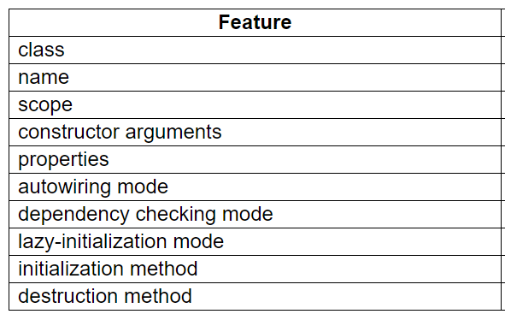
Spring Beans
BeanDefinition
The bean definition:
Notes:
Bean definition contains the information called configuration metadata, which is needed for the container to know the following −
How to create a bean
Bean's lifecycle details
Bean's dependencies
Besides bean definitions which contain information on how to create a specific bean, certain BeanFactory implementations also permit the registration of existing objects that have been created outside the factory (by user code). The DefaultListableBeanFactory class supports this through the registerSingleton(..) method. (Typical applications solely work with beans defined through metadata bean definitions though.)
Apart from the aforementioned, every bean has one or more ids (also called identifiers, or names; these terms refer to the same thing). These ids must be unique within the container the bean is hosted in. A bean will almost always have only one id, but if a bean has more than one id, the extra ones can essentially be considered aliases.

Slide 9
Bean Lifecycle
An Analogy

Slide 10
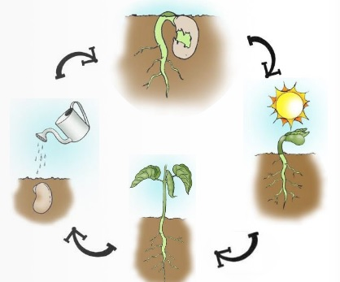
Bean Lifecycle
Analogy
Let us assume farmer is having a farmland cultivating by seeds(or beans). Here, Farmer is Spring Framework, Farmland land is Spring Container, Beans are Spring Beans, Cultivating is Spring Processors.
Like bean life-cycle, spring beans too having its own life-cycle.
Spring Beans

Slide 11
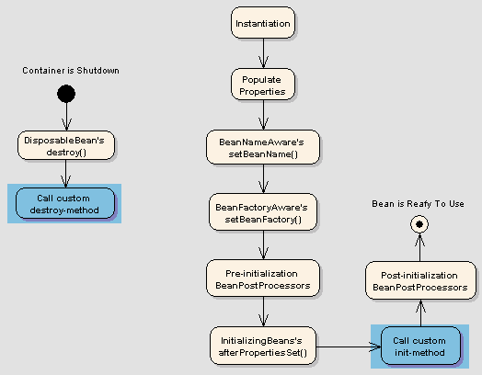
Bean Lifecycle
Steps
Following is sequence of a bean lifecycle in Spring:
Instantiate
Populate properties
Set Bean Name
Set Bean factory
Pre-Initialization
Initialize beans
Post-Initialization
Ready to use
Destroy
Spring Beans

Slide 12
BeanFactory
Using the container

Slide 13
BeanFactory
Overview
The interface for an advanced factory capable of maintaining a registry of different beans and their dependencies.
Enables you to read bean definitions and access them using the bean factory.
Resource res = new FileSystemResource("beans.xml");
BeanFactory factory = new XmlBeanFactory(res);
Notes:
A BeanFactory is essentially nothing more than the interface for an advanced factory capable of maintaining a registry of different beans and their dependencies.
The BeanFactory enables you to read bean definitions and access them using the bean factory.
When using just the BeanFactory you would create one and read in some bean definitions in the XML format as follows:
Basically, that is all there is to it.
Using getBean(String) you can retrieve instances of your beans; the client-side view of the BeanFactory is simple.
The BeanFactory interface has just a few other methods.

Slide 14
Spring Beans
How beans are managed by the IoC container

Slide 15
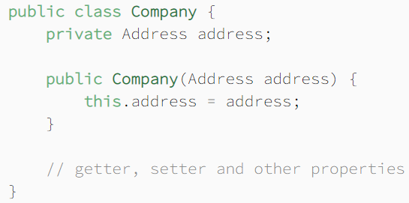
Inversion of Control (IoC)
Domain Classes
Assume we have a class declaration:
Spring Beans
Notes:
Inversion of Control (IoC) is a process in which an object defines its dependencies without creating them.
This object delegates the job of constructing such dependencies to an IoC container.
Let's start with the declaration of a couple of domain classes before diving into IoC.

Slide 16
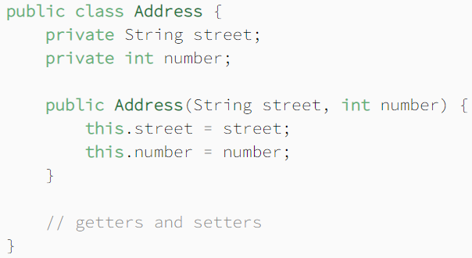
Inversion of Control (IoC)
Domain Classes
This class needs a collaborator of type Address:
Spring Beans

Slide 17

Inversion of Control (IoC)
Traditional Approach
Normally, we create objects with their classes' constructors:
There's nothing wrong with this approach, but wouldn't it be nice to manage the dependencies in a better way?
Spring Beans
Notes:
Imagine an application with dozens or even hundreds of classes.
Sometimes we want to share a single instance of a class across the whole application, other times we need a separate object for each use case, and so on.
Managing such several objects is nothing short of a nightmare. This is where inversion of control comes to the rescue.
Instead of constructing dependencies by itself, an object can retrieve its dependencies from an IoC container.
All we need to do is to provide the container with appropriate configuration metadata.

Slide 18
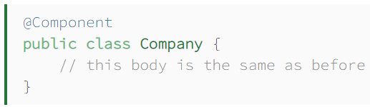
Inversion of Control (IoC)
Bean Configuration
The Company class with the @Component annotation:
Spring Beans
Notes:
First off, let's decorate the Company class with the @Component annotation:

Slide 19
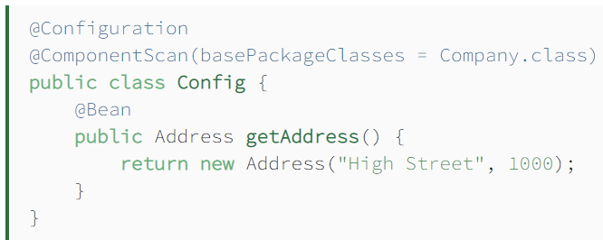
Inversion of Control (IoC)
Bean Configuration
@ComponentScan annotation instructs the container to look for beans in the package containing the Company class.
Spring Beans
Notes:
Here's a configuration class supplying bean metadata to an IoC container:
The configuration class produces a bean of type Address.
It also carries the @ComponentScan annotation, which instructs the container to look for beans in the package containing the Company class.
When a Spring IoC container constructs objects of those types, all the objects are called Spring beans, as they are managed by the IoC container.

Slide 20
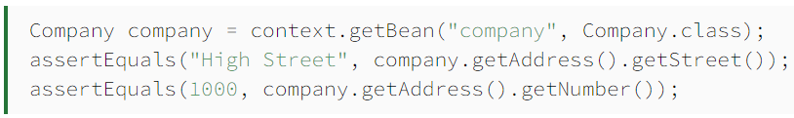
Inversion of Control (IoC)
IoC in Action
Creating an instance of the AnnotationConfigApplicationContext class to build up a container:
Test to verify the existence and the property values of our beans:
Spring Beans
Notes:
Since we defined beans in a configuration class, we'll need an instance of the AnnotationConfigApplicationContext class to build up a container:
A quick test verifies the existence and the property values of our beans:
The result proves that the IoC container has created and initialized beans correctly.

Slide 21

Quick Question
Beans defined in the spring framework are by default ______?
​
A. Abstract
B. Singleton
C. Final
D. Initialized
Spring Beans

Slide 22
Quick Question
Beans defined in the spring framework are by default ______?
​
A. Abstract
B. Singleton√
C. Final
D. Initialized
Spring Beans

Slide 23

Summary
This video gave a brief description of:
Spring Beans, and
Their relationship with the IoC container.
Spring Beans

Slide 24

Thank You!

